Slide 1
Logos and symbols
MODULE 3

Slide 2
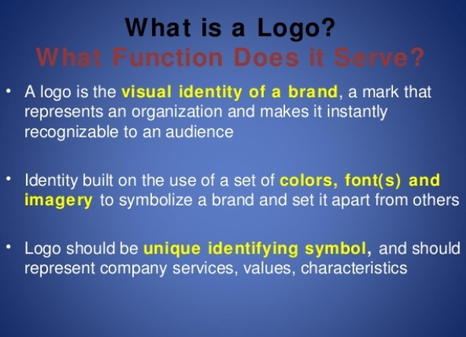

Slide 3
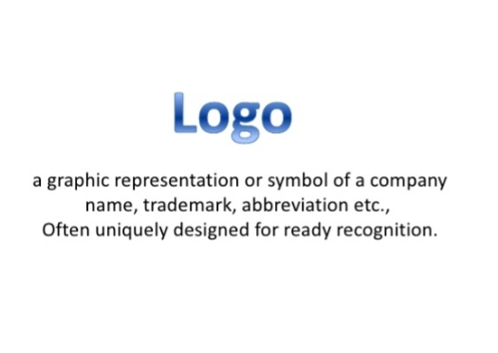

Slide 4
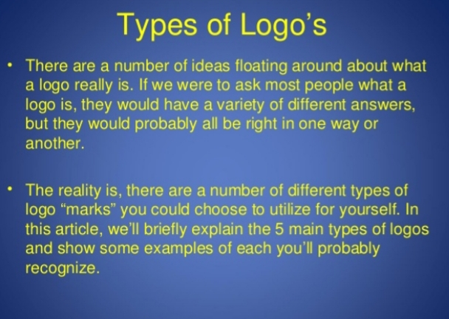

Slide 5
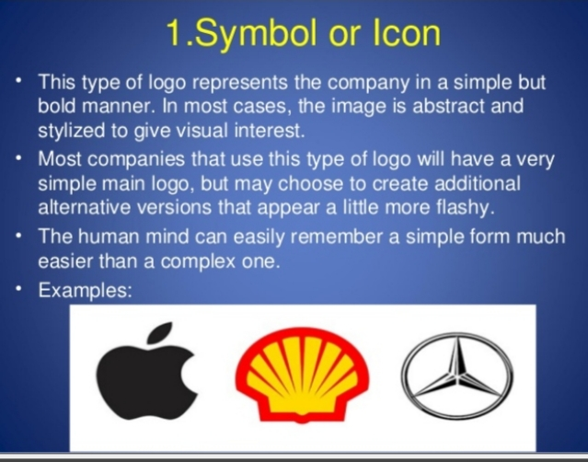

Slide 6
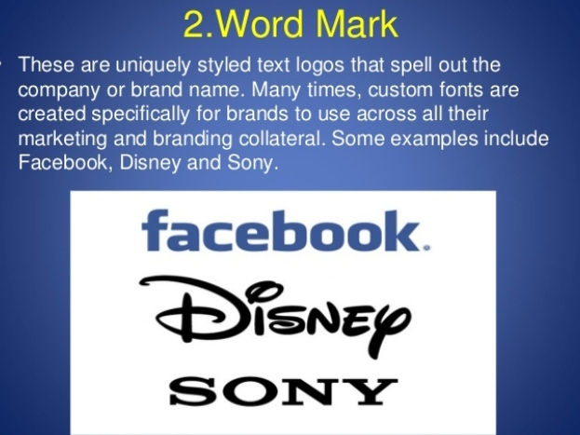

Slide 7
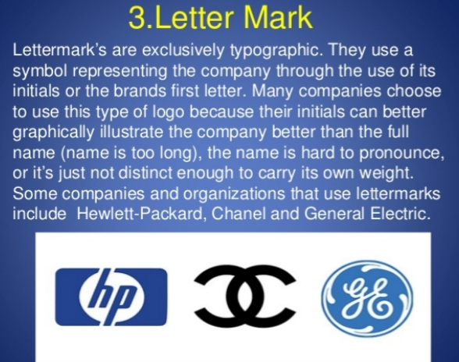

Slide 8
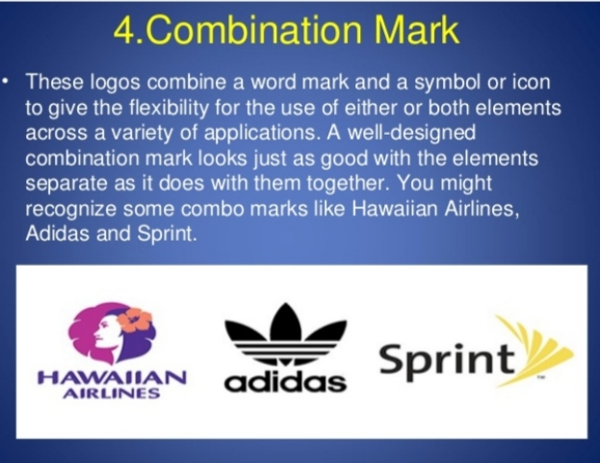

Slide 9
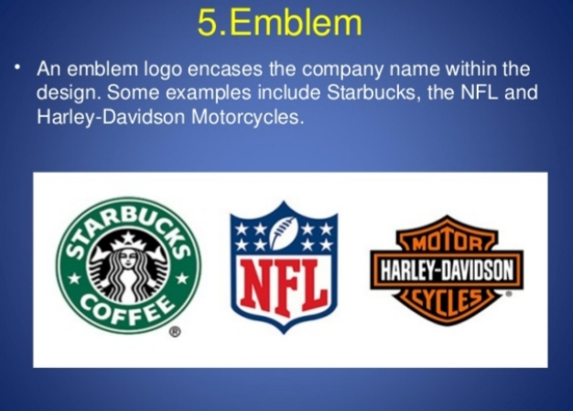

Slide 10

Some interesting logos and meanings....

Slide 11
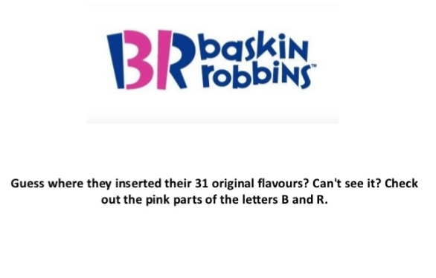

Slide 12
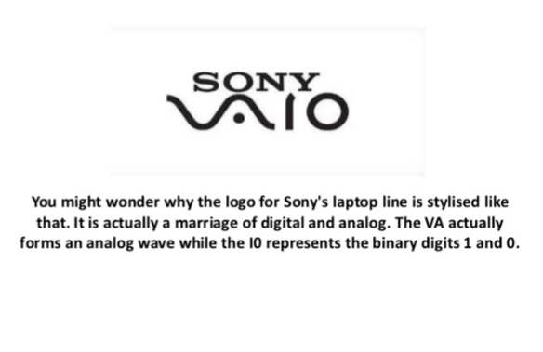

Slide 13
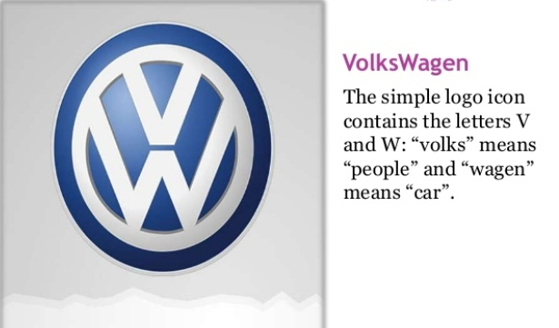

Slide 14
Logos are symbols that represent a company, a product or a brand
Register an image in customers mind
Logos should be attractive, unique and functional
Trademark logos represent a company’s intellectual property
Logos are trademarked – cannot be used by anyone else
A trade mark logo gives exclusive rights to the owners

Slide 15
Elements of a good Logo
Lasting value
Distinct
Appeal
Supports USP
Legible

Slide 16
Dos and Donts of Successful Logo Design
1 Simple, straightforward and clear
Donts – using too many words defeat its purpose
2 Be unique
Different
Dont – imitate a particular trend or movement
3 colour
DO- Get suggestion from an artist or designer
Research the meaning of every colour

Slide 17
Versatality
Do – logo can be used in a variety of platforms –in every possible media available
Donts – never stick to one version of logo design.
Typography
Do - Easy to read and maximum of two fonts in a logo
Donts - Never overuse fonts
Never use shadows for fonts

Slide 18
Audience
Do -Scientifically study and collect data about audience
Dont- Do not ignore the feedback, comments and suggestions from people
Inspiration
Do- Logo design should be drawn out .
Use vector design graphic software
Dont - Do not copy from other designs

Slide 19
Consistency
DO - Visual consistency is necessary .
Dont - Do not change logo too often
changing it will confuse customers
Space
Do - Use the advantage of space left out by incorporating meaning
Dont - Never use space into logo design without putting meaning into it
Know your Design
Do - Design must be meaningful
Dont - Logo created should not be detached from the company and brand

Slide 20
Lines
DO - Simple lines and bold shapes will make design recognizable
Dont - Never use confusing lines
In motion
Do - Make a moving version of the logo design
Dont - Never stick to a passive design

Slide 21
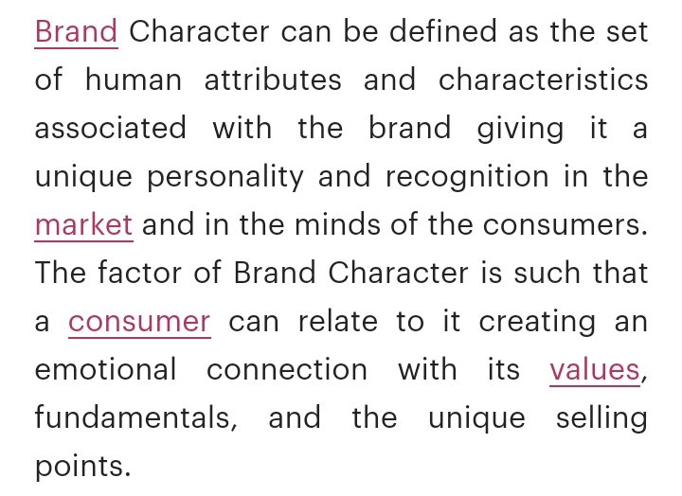
Characters

Slide 22
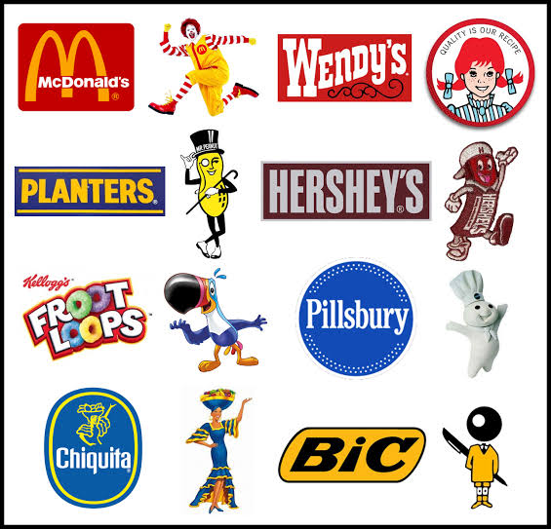

Slide 23
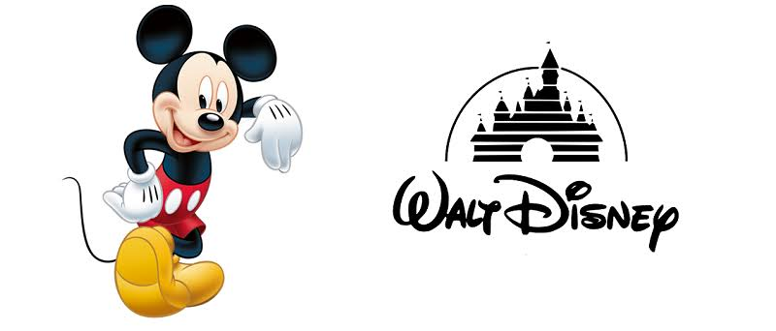

Slide 24
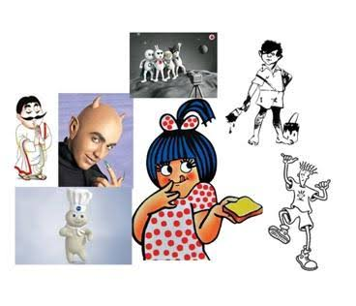

Slide 25
Benefits
Helps to differentiate the product
Colourful and rich in imagery, grab attention of customers
Helps to stand out in the market clutter
Give life to the brand experience
Will provide instant personality and appeal , encouraging memorable associations
Become valuable licensing properties , provide direct revenue and additional brand exposure

Slide 26
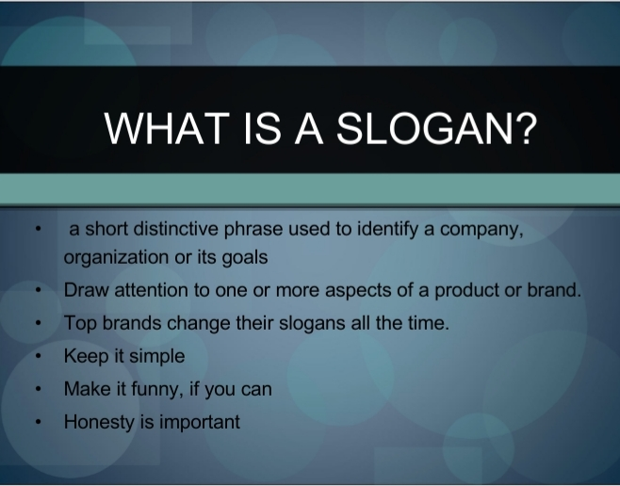
Slogans

Slide 27
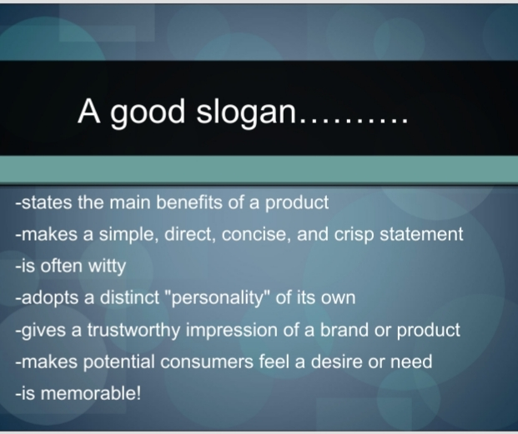

Slide 28
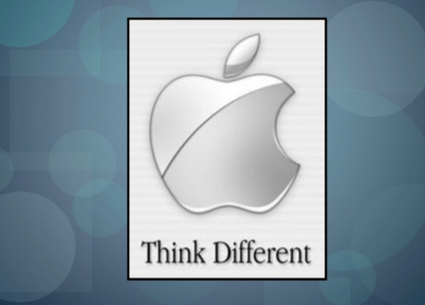

Slide 29
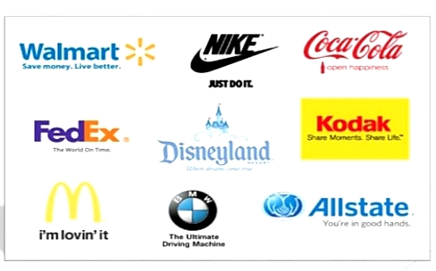

Slide 30


Slide 31
Benefits
Bulid brand awareness and image
Create strong link with the brand
Helps to create brand equity
Helps customers understand the meaning of the brand
Effectively used in advertising

Slide 32
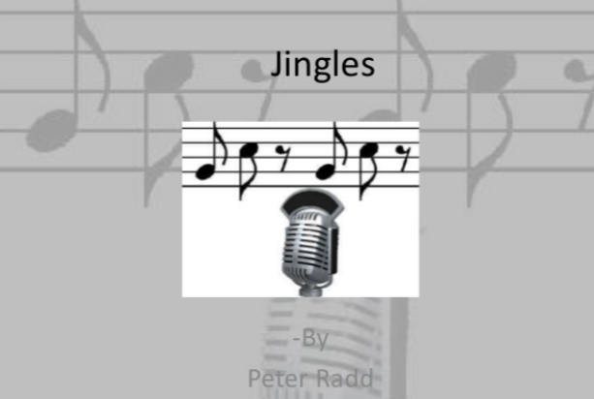
Jingles

Slide 33
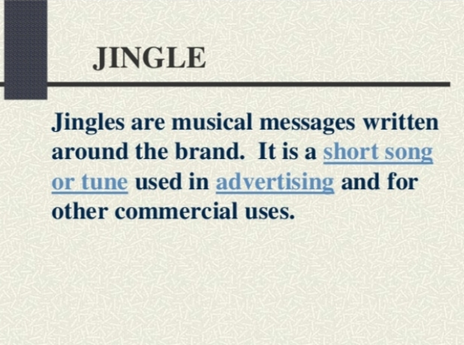

Slide 34
Facilitate memorization
AMUL- UTTERLY.BUTTERLY DELICIOUS
CADBURY DIARY MILK- KYA BAAT JINDAGI KI

Slide 35
Benefits
More listener awareness than plain words
Professional attitude towards corporate identity
Improves effectiveness of advertisement
Build branding for the company

Slide 36
Packing and packaging
Packing – wrapping of goods before they are transported or delivered to customers
Packaging – sub division of packing function
Activity which is concerned with protection, economy, convenience and promotional considerations
William J Stanton
Packaging may be drfined as the general group of activities in product planning which involves designing and producing a container or wrapper for a product

Slide 37
Benefits of packing and packaging
Product Attractiveness – size, shape, colour and printed matter makes product attractive
Product identification – differentiates similar products
Product Convenience – can be easily handled, opened, moved etc
Effective Sales tool - attractive package invites sales

Slide 38
Trademark
A distinctive sign used by a firm to show that the products and services are originated from a unique source and distinguish them from that of other firms
American Marketing Association
A trade mark is a brand or a part of a brand that is given legal protection because it is capable of exclusive appropriation
Word, name , phrase logo, image, symbol, design or a combination of these elements
Legally protected brand name
Trade mark is a legal terminology
Owner can take Legal action against the unauthorized use of the trademark

Slide 39
Need and importance
Legal protection to brand and brand name
Protects the consumers – firms are legally responsible for substandard products marketed through trademarks
Customers can clearly differentiate the brand by identifying trademarks
More acceptance and appreciation from customers
It increases authenticity of the brand

Slide 40
Taglines
A short memorable description that clearly communicates the brand message
Helps in positioning the product in the market
Get stuck to customers brain
Communicates brand personality to customers
Communicates overall benefit of the product

Slide 41
7 types
Imperative Taglines
Usually begin with a verb and command the customers to perform an action
Nike - Just Do It
Youtube – Broadcast yourself
Coca Cola – Open Happiness

Slide 42
Descriptive Taglines
Most straightforward taglines which describes brand offering , benefits etc in simple words
Save Money Live Better – Walmart
KFC –its finger- lickin’ good

Slide 43
Provocative tagline
Thought provoking and stimulating
Stop and think
Adidas – impossible is nothing
Dove – you are more beautiful than you think

Slide 44
Superlative taglines
Highest degree of comparison
BMW – THE ULTIMATE DRIVING MACHINE

Slide 45
Interrogative Taglines
Use questions to direct you to perform an action , think in a specific manner or communicate other message

Slide 46
Specific Tagline
Use words cleverly to reveal the brands product or business caregory and make it memorable
Drivers wanted – Volkswagen

Slide 47
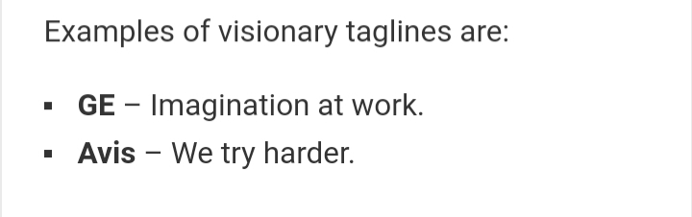
Visionary Tagline
Communicates Brand vision to target audience

Slide 48


